Slide 1
BagWati: Journeys By Your Design. Rushikesh Zende Rahul Autade Vaibhava Krishna Devulapalli
Final project for CSCI 5551 Section 2 Fall 2023, University Minnesota
12/20/2023

Slide 2
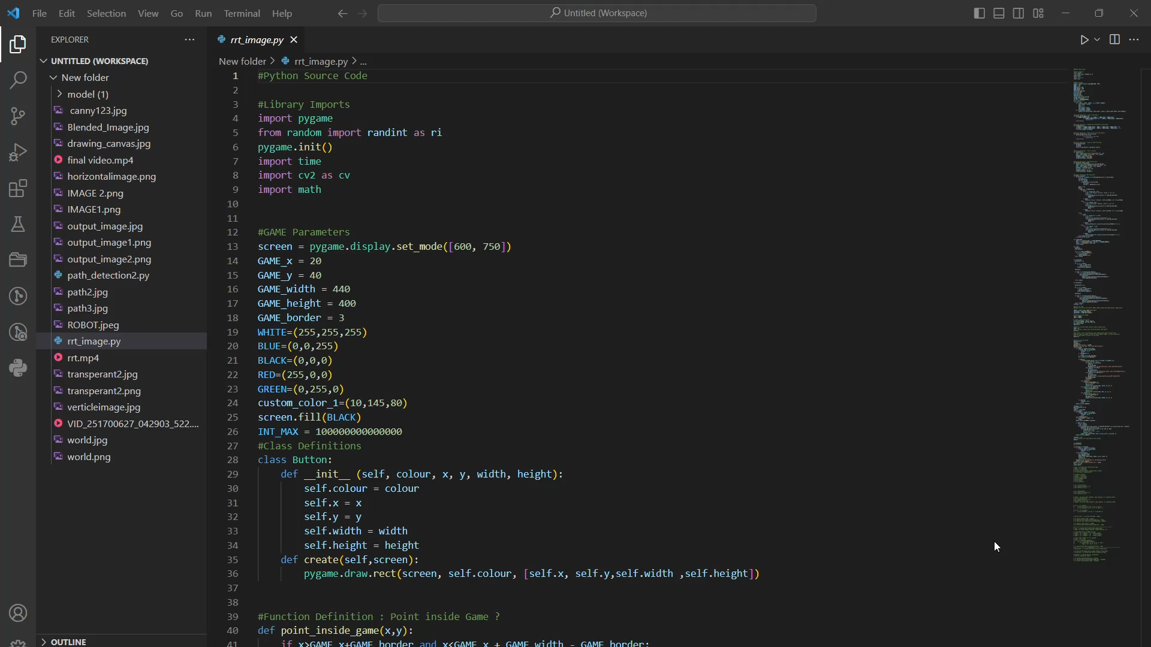
Video Of Success Case:
Successfully running RRT on a User Defined Path.

Slide 3
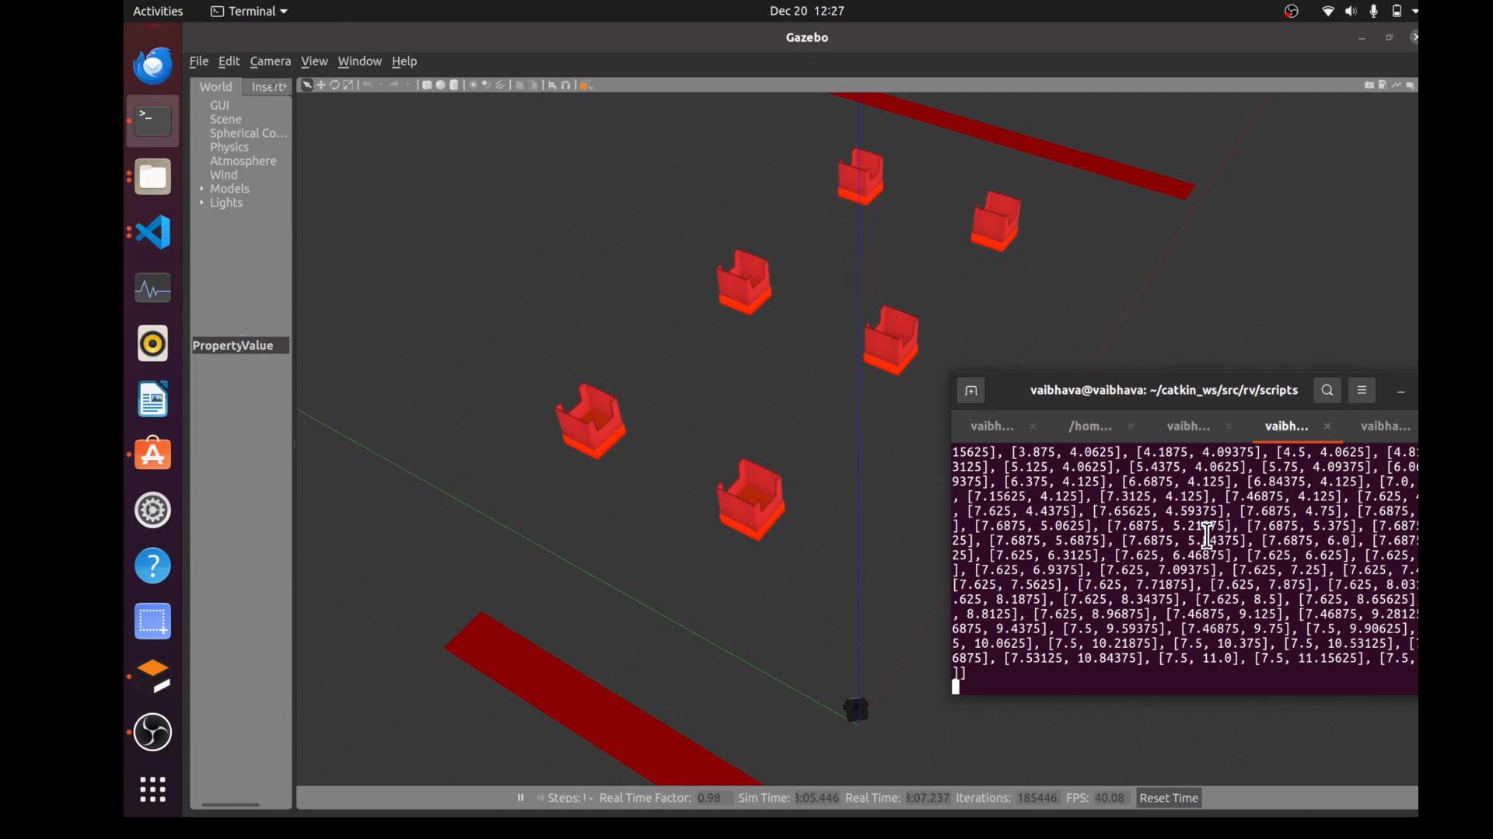
Video Of Success Case:
Successfully running of bot in Gazebo

Slide 4
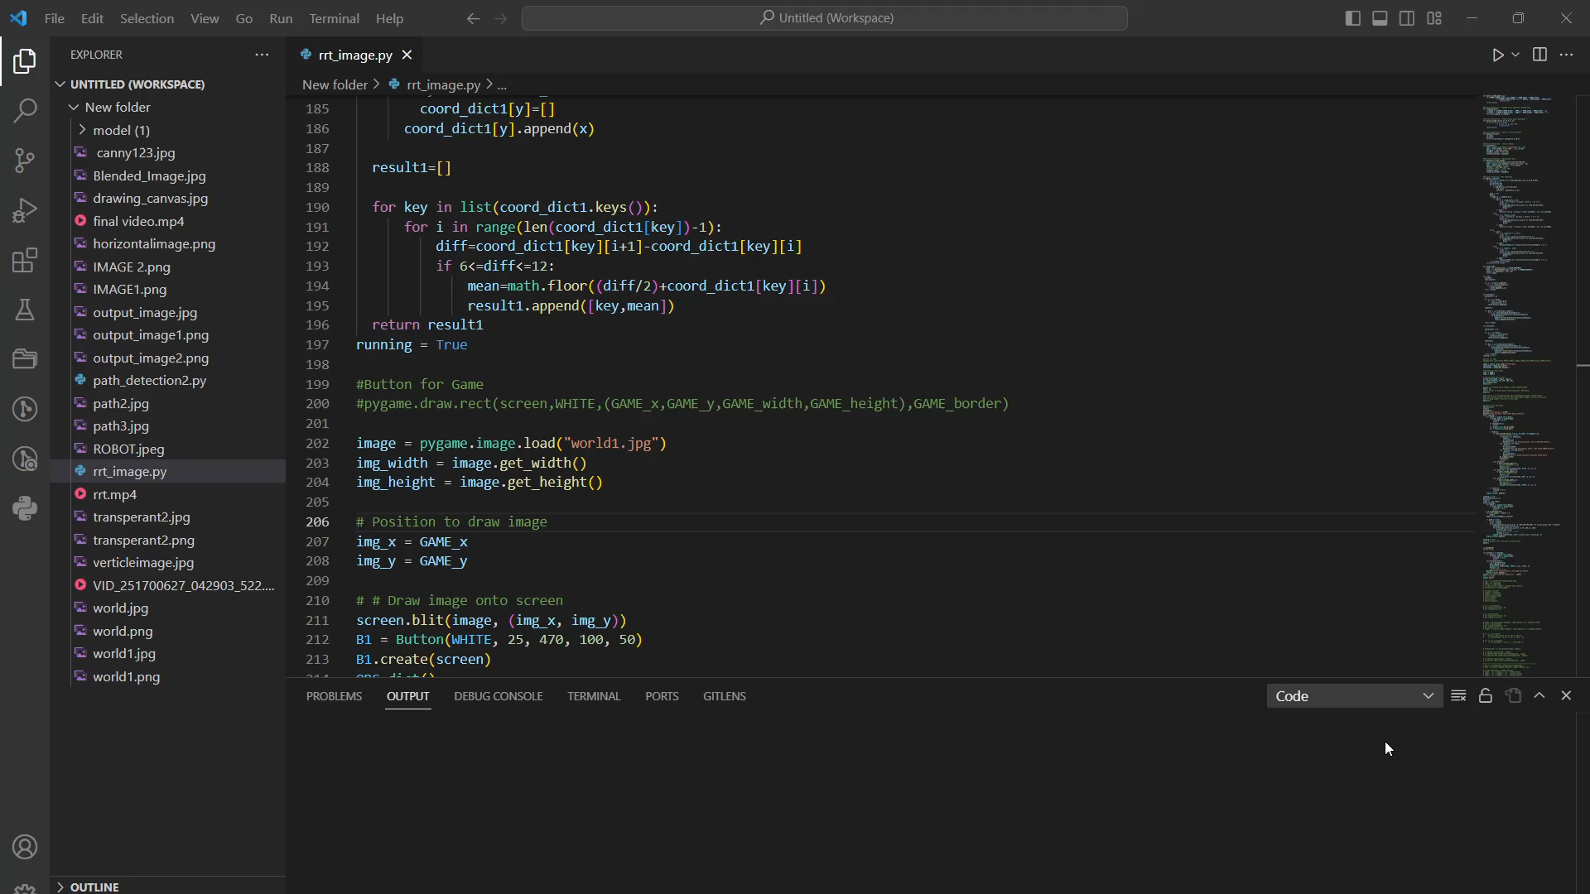
Video Of Failure Case:
RRT was getting confused between pixel values for a User Defined Path.

Slide 5
Other Failure Cases:
Generating pixel co-ordinates in the sequence of path
Importing path co-ordinates into the ROS
Scaling of path from image to simulated environment

Slide 6
Performance Matric
Path Generation: path is generated with 95% points inside the user defined path
Scaling of path: successfully scaled path from map to simulated environment.
Traversal of Path:

Slide 7
Conclusion
Limitations:
Speed of traversal
Dynamic obstacle avoidance
Too many segment points are generated in RRT
Scope:
Cost-effective real-world applications in:
Baggage transportation at airports
Material handling in industries.

Slide 8
Thank You!

